Slide 1
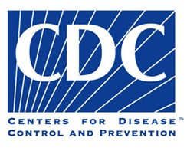
Human Papillomavirus Vaccination Coverage Among Adolescents, 2007–2013, and Postlicensure Vaccine Safety Monitoring, 2006–2014 — United States
Presented by
Bongeka Zuma

Slide 2
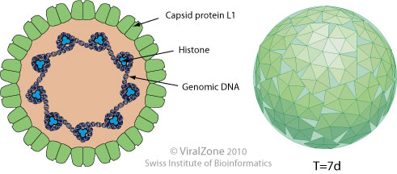
What is Human Papillomavirus (HPV)
Papillomaviruses belong to the Family Papillomaviridae¹
Papillomaviruses are small, non-enveloped and double-stranded DNA viruses²
Image ³

Slide 3
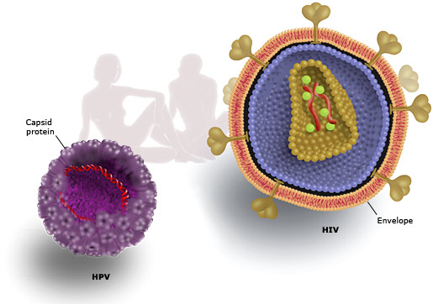
Structure of the human papillomavirus
Image⁴

Slide 4
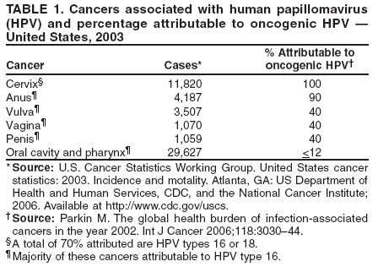
Diversity of Human Papillomavirus
HPV is highly diverse and likely to occur in most mammals and birds.⁵

Slide 5
Immunology and Diagnosis
The Human Papillomavirus are mostly protected from the host immune response because they are mostly restricted to the epithelium.
To detect HPV, the genetic information needs to be identified - mostly the DNA.
Methods:
Digene Hybrid Capture® 2 (HC2) High-Risk HPV DNA Test (Approved by FDA) - Nucleic Acid Hybridization
Nucleic acid amplification methods e.g. PCR
Enzyme immunoassays, designed to detect antibodies to the viral protein⁵

Slide 6
Epidemiology
Primarily transmitted by genital contact, usually through sexual intercourse.⁶
The most consistent way to predict infection is by analyzing sexual activity, most importantly the number of sex partners (lifetime and recent).⁷
It may also be transmitted through other types of genital contact aside from penetrative intercourse but this is less common.⁶

Slide 7
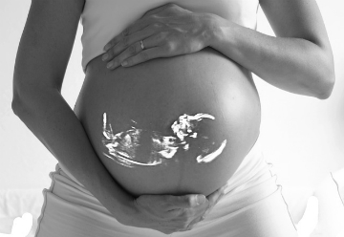
Epidemiology
Although less common, genital HPV may also be transmitted through nonsexual ways such as from a mother to a newborn baby.⁶

Slide 8
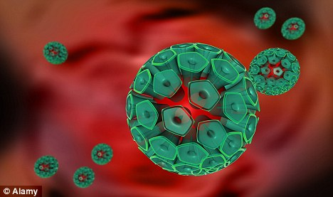
Statistics in the U.S.
More than 80% of sexually active women will have acquired genital HPV by age 50 years.⁸
An estimated 6.2 million new HPV infections occur every year among persons aged 14--44 years.⁶
Out of these, 74% occur among those aged 15--24 years.⁶

Slide 9
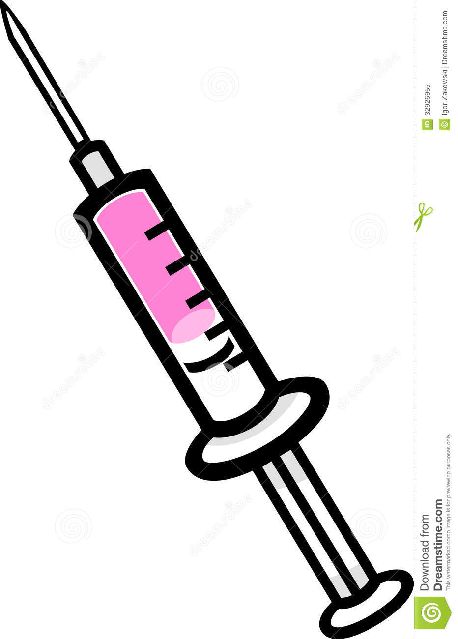
The Study
Advisory Committee for Immunization Practices (ACIP) - sets vaccination schedule.
National Immunization Survey (NIS) - is monitors vaccination coverage.
Recommended schedule HPV vaccinations schedule:
3-dose series - 2nd and 3rd doses administered 2 and 6 months after the first dose. Recommended age for vaccination of females is 11--12 years but can be administered as young as 9.¹

Slide 10

Aim of study
To assess progress with HPV vaccination coverage among adolescents aged 13-17 years
Characterize adherence with recommendations for HPV vaccination by 13th birthday
Describe HPV vaccine adverse reports post licensure

Slide 11
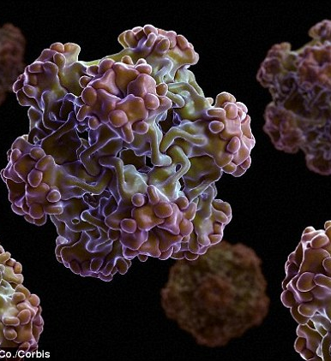
Significance of Study
Improve the delivery of vaccines to children.
Reduce the cost of vaccines for parents.
Enhance awareness, partnerships, and community participation.
Improve vaccinations and their use.
Monitor vaccination coverage and occurrences of disease
Image⁹

Slide 12
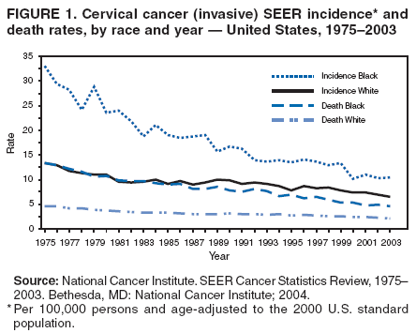
Significance of Study¹

Slide 13

Experimental design
Sampling Design
Vaccine Safety
2007–2013 National Immunization Survey-Teen (NIS-Teen)
Postlicensure vaccine safety monitoring and evaluation are conducted independently by federal agencies and vaccine manufacturers.
Reported to VAERS

Slide 14

Sampling Design
Collection of Random Numbers
Immunization History Questionnaire (IHQ)
Random Digit Dialing Survey
(RDD)
Request for consent to contact child’s vaccination provider
Reason for the call and purpose of survey
Identification of households that have children in age-range
Questions about relationship to the child and socioeconomic

Slide 15

Weakness in paper/study
Incomplete records from guardians or parents can cause an underestimation of vaccine coverage.
The safety report relies solely on the discretion of the person reporting and that they will come forward.
Vaccination providers may not comply with releasing patient information.

Slide 16
Results

Slide 17
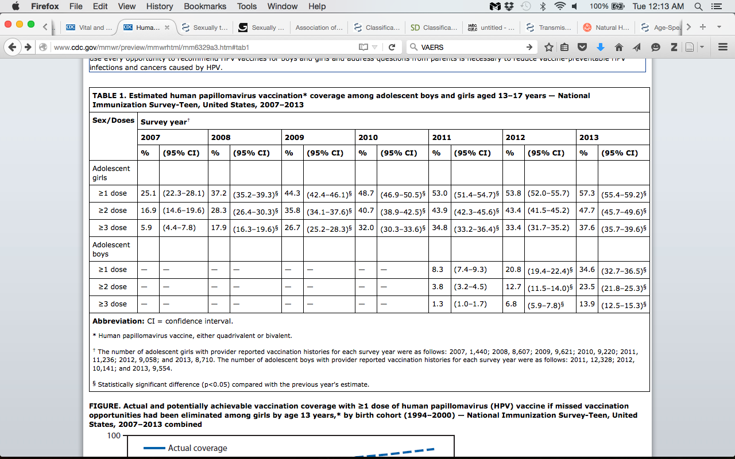

Slide 18
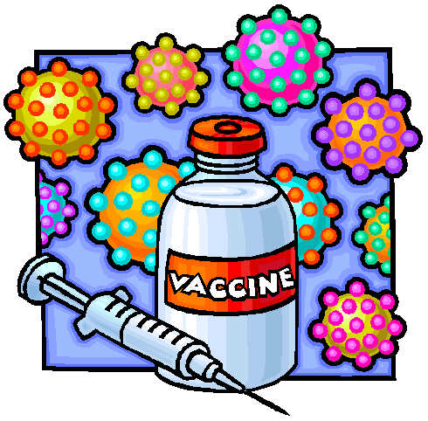
Results
HPV vaccination coverage in 2013 increased 2012.
In girls
Receipt of ≥1 dose of HPV
by age 13 years increased by
an average of 5.9%

Slide 19
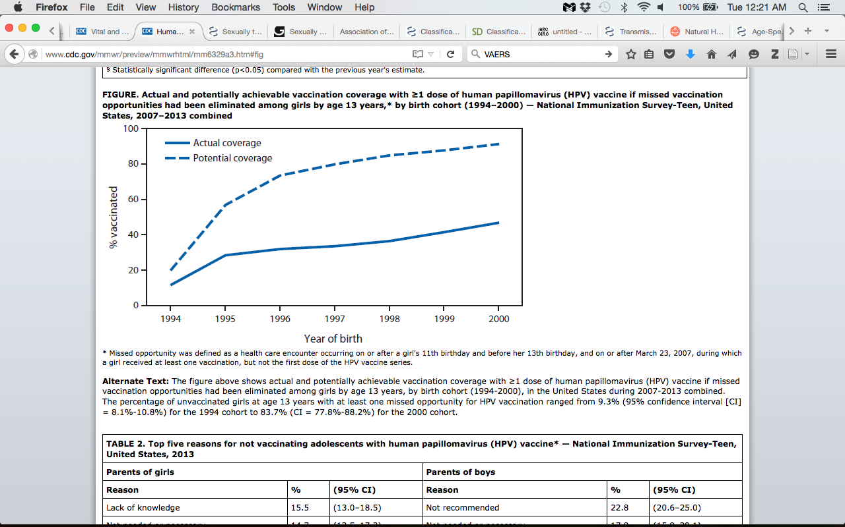

Slide 20

Results
If all missed opportunities for HPV vaccination had been eliminated for the 2000 birth cohort, vaccination coverage with ≥1 dose of HPV vaccine could have reached 91.3% by age 13 years, a 44.5 percentage-point difference from the actual coverage level.

Slide 21

Results
Very minor adverse effects from the vaccine were reported.
The 2013 NIS-Teen asked parents who reported they were not likely to vaccinate their teen in the 12 months after interviews or were unsure of their vaccination plans

Slide 22
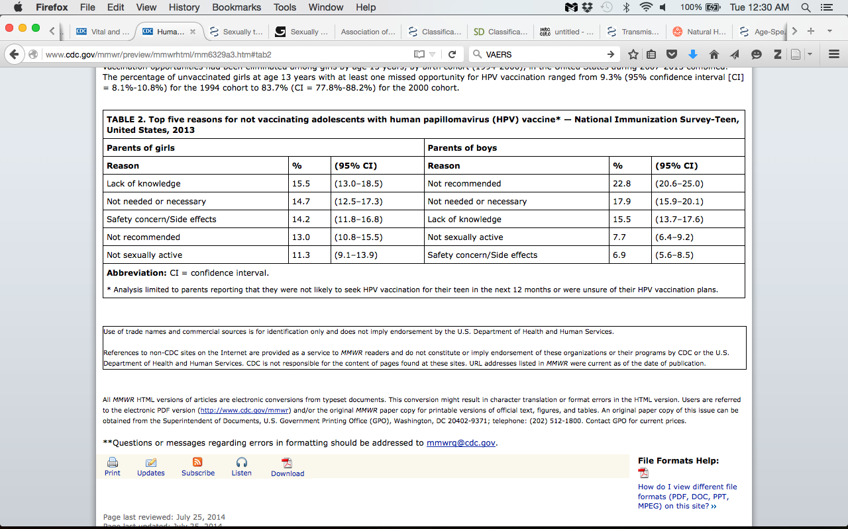

Slide 23
Conclusion and Discussion
Results from the 2013 NIS-Teen survey show a slow increase in the coverage of the vaccine
2012 to 2013
Percentage of of adolescents receiving ≥1 dose of HPV increased by 3.5% for girls and 13.8% for boys.
Cohort analysis also performed to evaluate receipt ≥1 dose of HPV vaccine by 13 years
increased since 2007
Missed vaccination opportunities persist

Slide 24
Conclusion and Discussion
Safety and effectiveness of HPV vaccine
Main reasons for not vaccinating
Lack of recommendation from clinicians
Lack of knowledge
A large number of parents are still not being recommended for vaccine

Slide 25
Future Directions
Educate vaccination providers
Increase parents’, caregivers and adolescents’ acceptance of HPV vaccination
Maximum access to HPV vaccination
Address gaps
Website dedicated for health care professionals
A tip sheet for talking about the HPV vaccine with parents
Evidence based campaigns

Slide 26
References
de Villiers, E.-M., Fauquet, C., Broker, T. R., Bernard, H.-U. & zur Hausen, H. Classification of papillomaviruses. Virology 324, 17–27 (2004).
IARC Monographs on the Evaluation of Carcinogenic Risks of Humans .pdf. at <http://monographs.iarc.fr/ENG/Monographs/vol90/mono90.pdf>
SIB Swiss Institute of Bioinformatics. ViralZone: root. Viral Zone: Papillomaviridae at http://viralzone.expasy.org/
www.nobelprize.org
Markowitz, L. E. et al. Quadrivalent Human Papillomavirus Vaccine Recommendations of the Advisory Committee on Immunization Practices (ACIP). at http://www.cdc.gov/mmwr/preview/mmwrhtml/rr5602a1.htm
Weinstock, H., Berman, S. & Cates, W. Sexually transmitted diseases among American youth: incidence and prevalence estimates, 2000. Perspect. Sex. Reprod. Health 36, 6–10 (2004).

Slide 27
References
Ho, G. Y. F., Bierman, R., Beardsley, L., Chang, C. J. & Burk, R. D. Natural History of Cervicovaginal Papillomavirus Infection in Young Women. N. Engl. J. Med. 338, 423–428 (1998).
Myers, E. R., McCrory, D. C., Nanda, K., Bastian, L. & Matchar, D. B. Mathematical Model for the Natural History of Human Papillomavirus Infection and Cervical Carcinogenesis. Am. J. Epidemiol. 151, 1158–1171 (2000).
University of Glasgow - Research Institutes - Institute of Infection, Immunity and Inflammation - MRC-University of Glasgow Centre for Virus Research - Public Engagement - Viruses: a century of discovery - 1930s Viruses made visible. at <http://www.gla.ac.uk/researchinstitutes/iii/cvr/public%20engagement/virusesacenturyofdiscovery/1930svirusesmadevisible/>

